Slide 1
NAME: ABDUR RAFAY ROLL NUMBER: CS-22131 DEPARTMENT: CIS
AVIATION

Slide 2
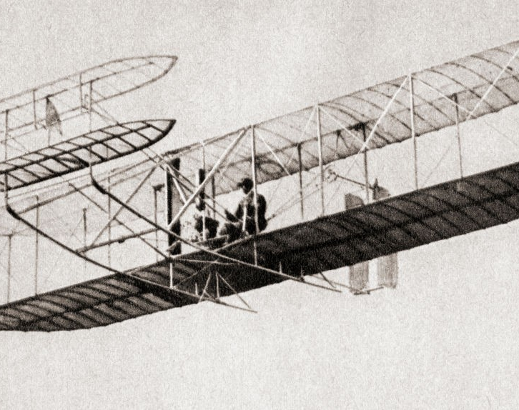
History of Aviation:
The history of aviation is a long and fascinating one.
Wright brother were the first to ever do a successful flight. They designed and built the Wright Flyer, which flew for the first time on December 17, 1903, near Kitty Hawk, North Carolina. The Wright brothers' first powered aircraft, the Wright Flyer, stayed in the air for a total of 12 seconds on its first flight.

Slide 3
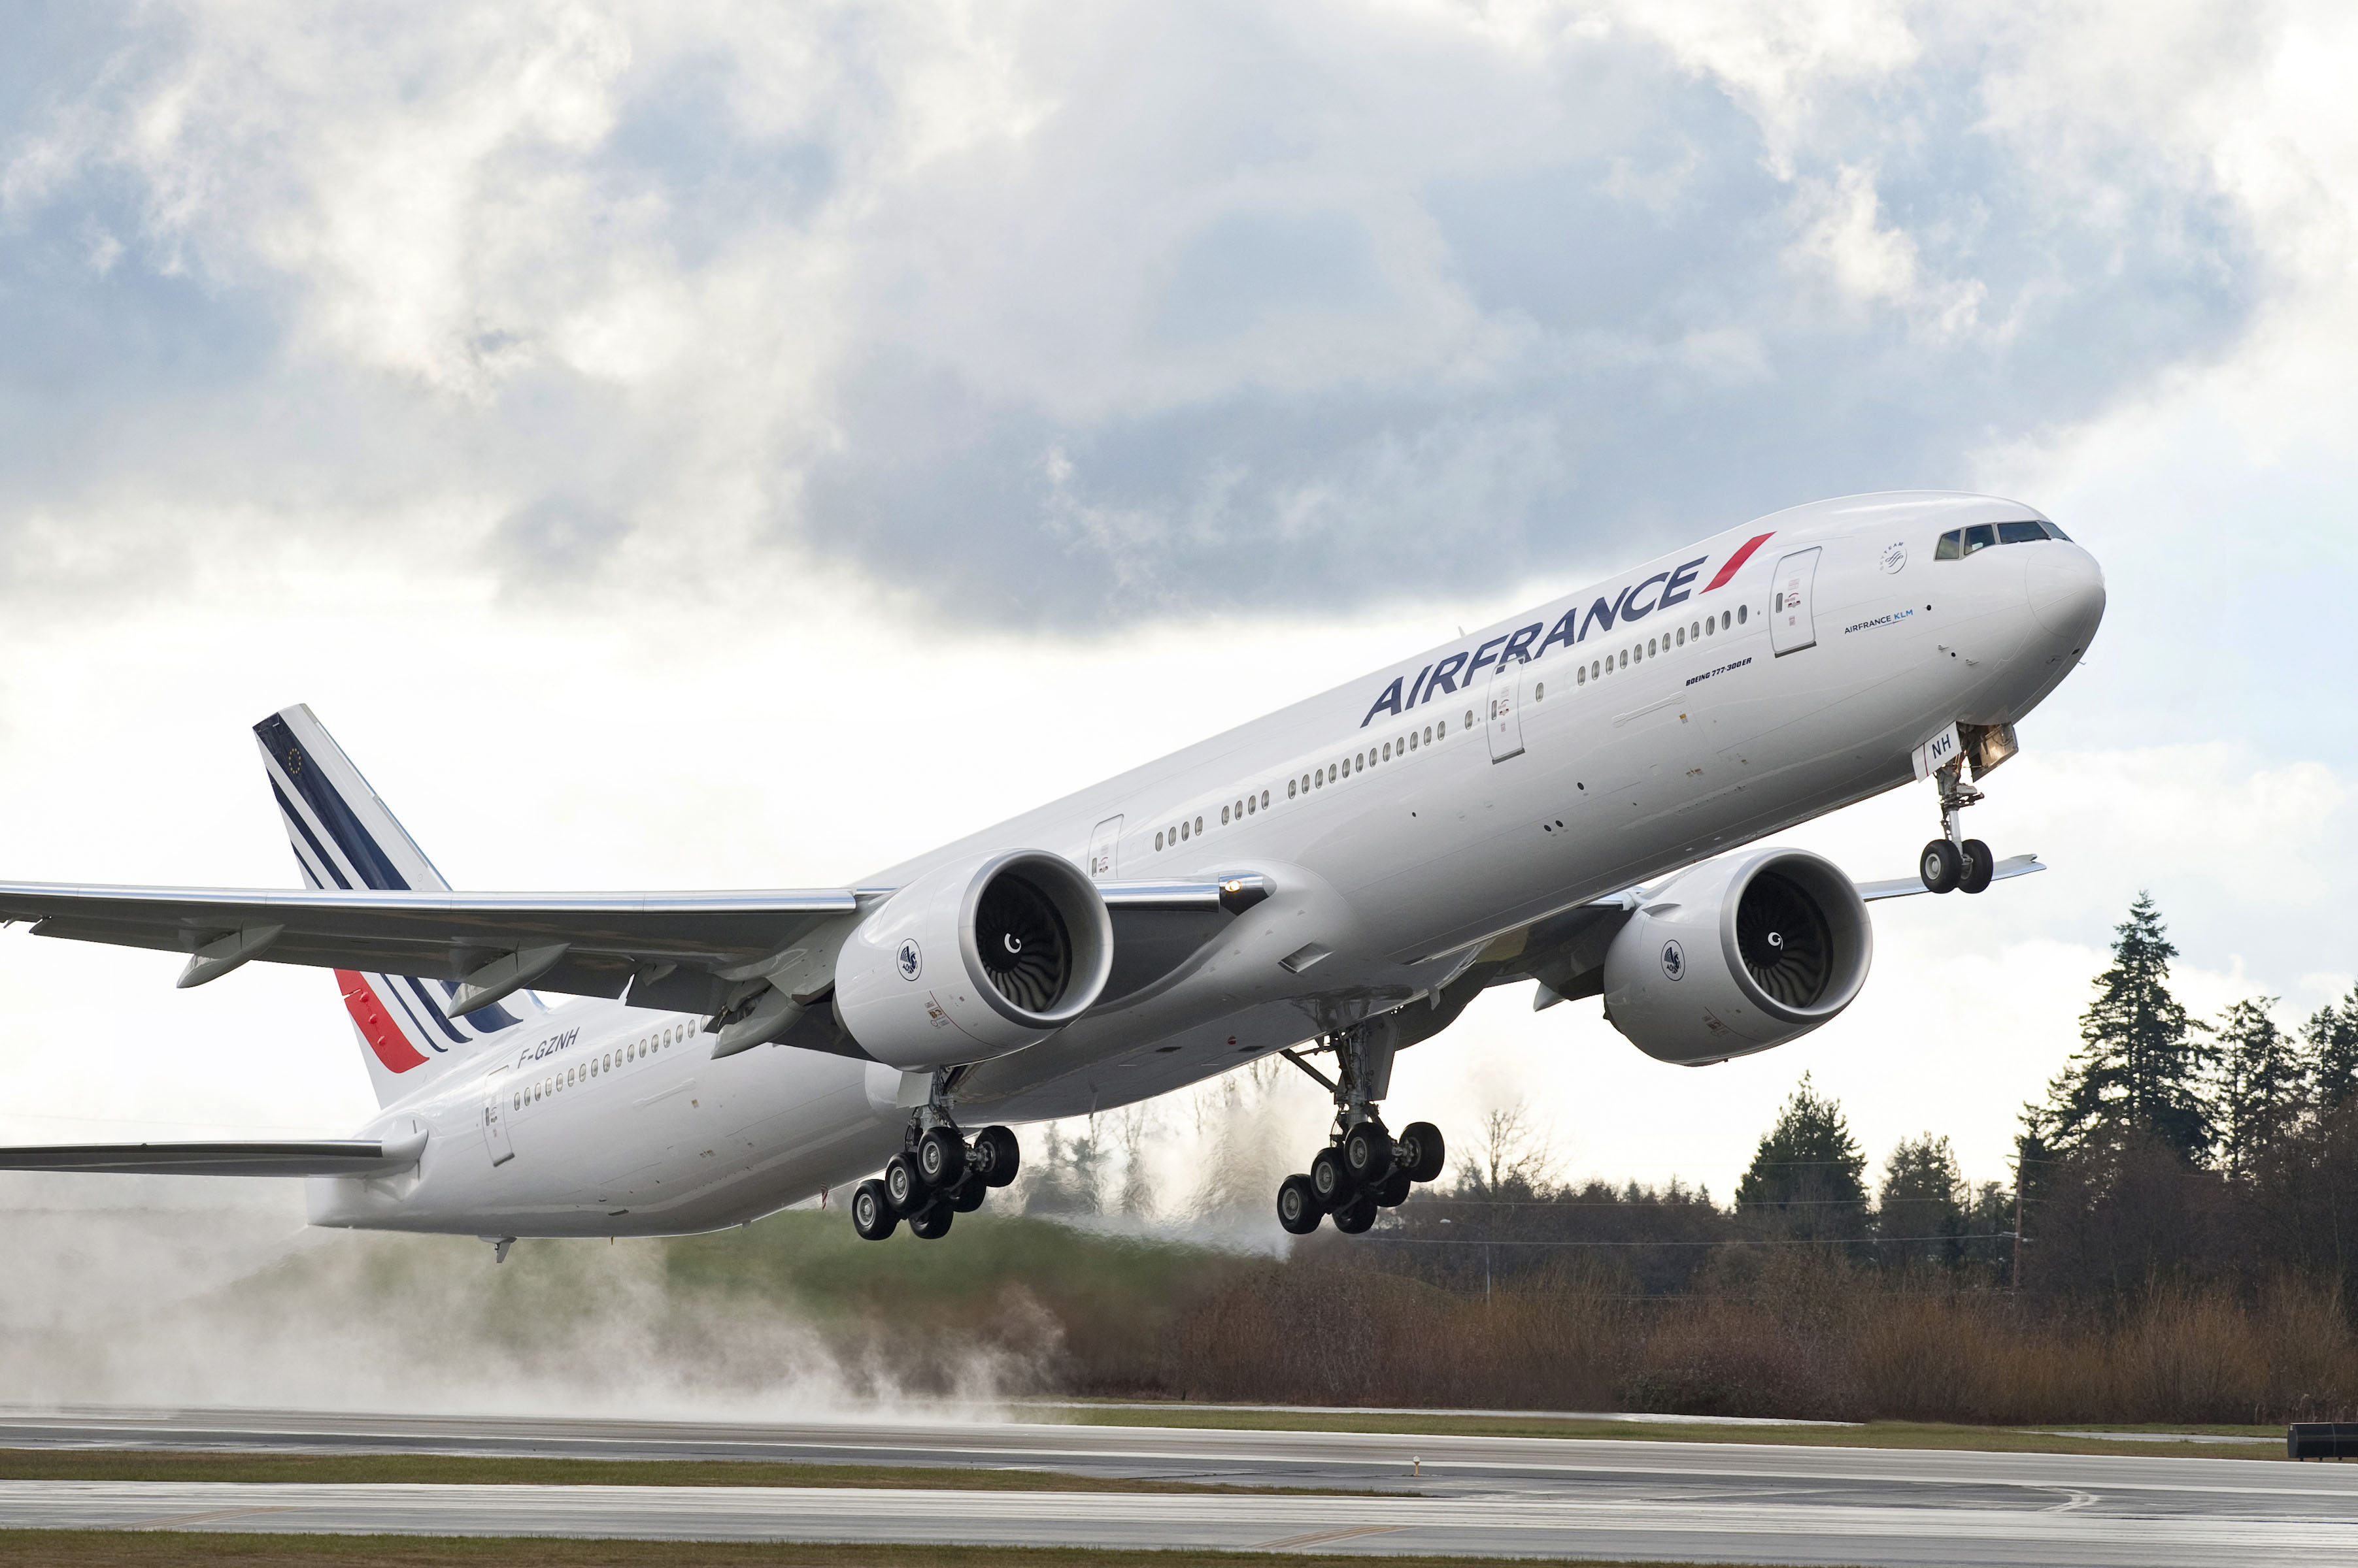
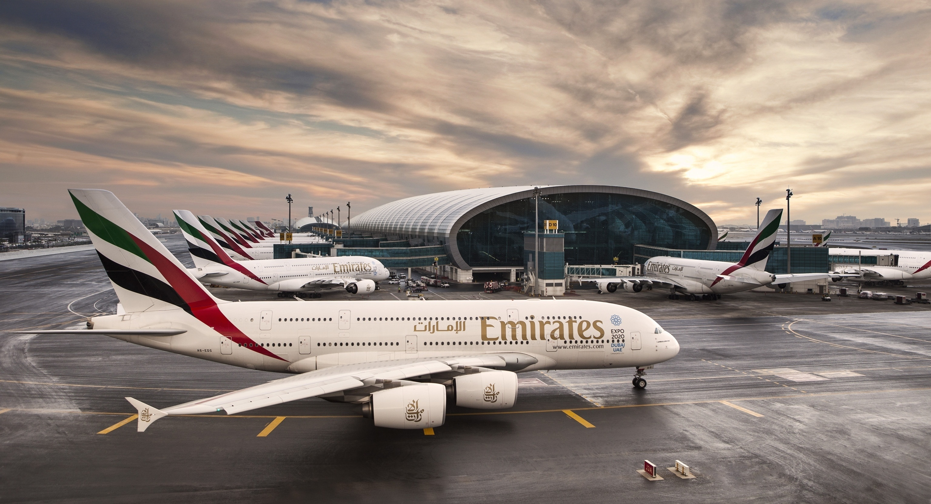
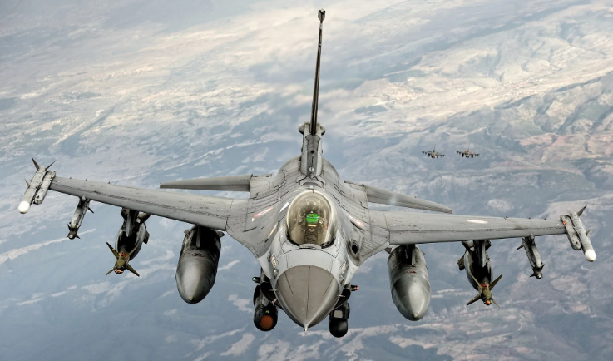
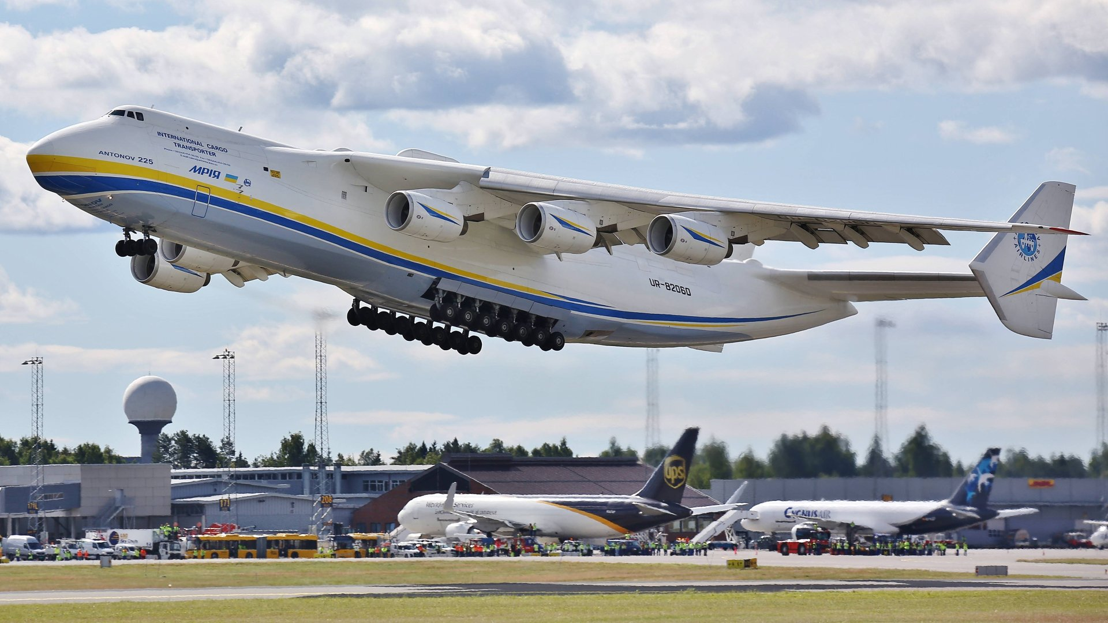
Classes of Aircrafts:
Military Aircrafts:
Military aircrafts includes Fighter jets(Bottom Left), Air Fuelers, Reconnaissance planes, Stealth and Spy Planes. Aircrafts in military class includes F-22 Raptor, F-16, Eurofighter, SU-35, SR-71, Harrier etc.
Commercial Aircrafts:
Commercial aircrafts includes planes that are used for transportation(Top). Top models includes A-380, B-777, B-787, A-320 etc.
Cargo Plane:
Cargo, also known as freighters, specifically designed to carry cargo. Used to transport things like food and manufacturing parts(Bottom Right).Top model includes AN-225 Mriya, Beluga etc.

Slide 4
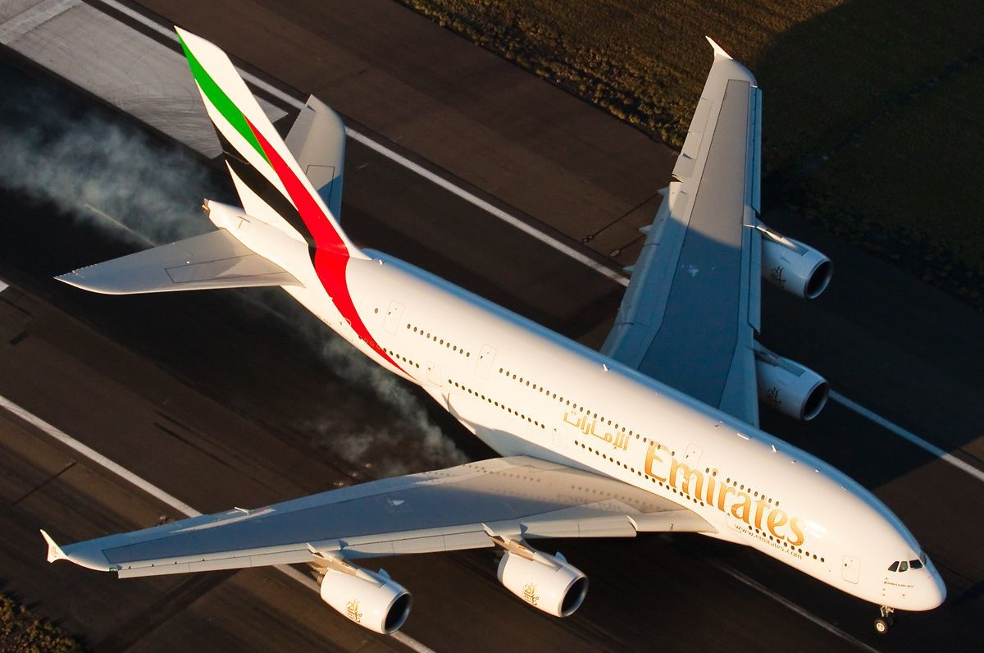
Components of an Aircraft:
Tail
Stabilizers
Ailerons
Fuselage
Engine
Flaps
Landing Gears
Wings

Slide 5
Careers in Aviation:
1. PILOT:
Pilot is the person operating the aircraft. There are two classes of operator. Pilot and Captain. Both decide with each other about who will operate the aircraft who will command the other.
2. Aerospace Engineer:
Aerospace engineer’s task is to design and build aircrafts. Designing an aircrafts needs immense knowledge and engineering capabilities. There are two main companies for commercial aircrafts, Boeing and Airbus.
2. Air Traffic Controller:
An air traffic controller is responsible for ensuring the safe and efficient movement of aircraft within an assigned airspace. They use radar and other equipment to monitor and control the movement of aircraft, provide information to pilots, and issue instructions to ensure that aircraft are separated from one another and maintain a safe distance at all times.
Maintenance Technician:
A maintenance technician is responsible for performing routine and scheduled maintenance on aircraft, as well as troubleshooting and repairing problems when they arise. They may work on various systems of the aircraft, such as the engines, hydraulics, electrical systems, and avionics.

Slide 6
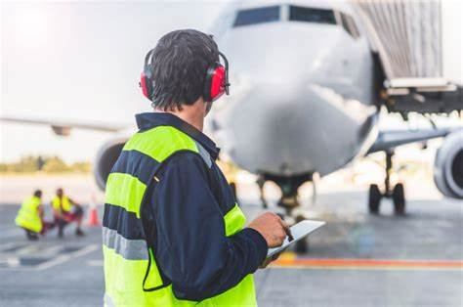
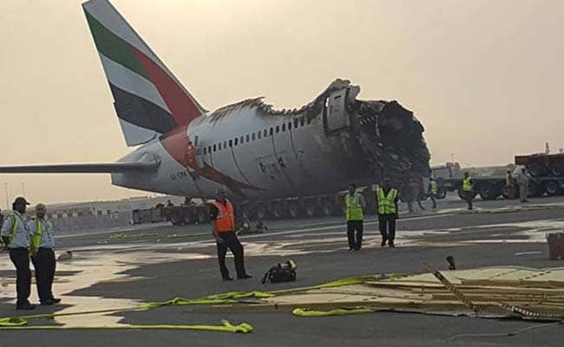
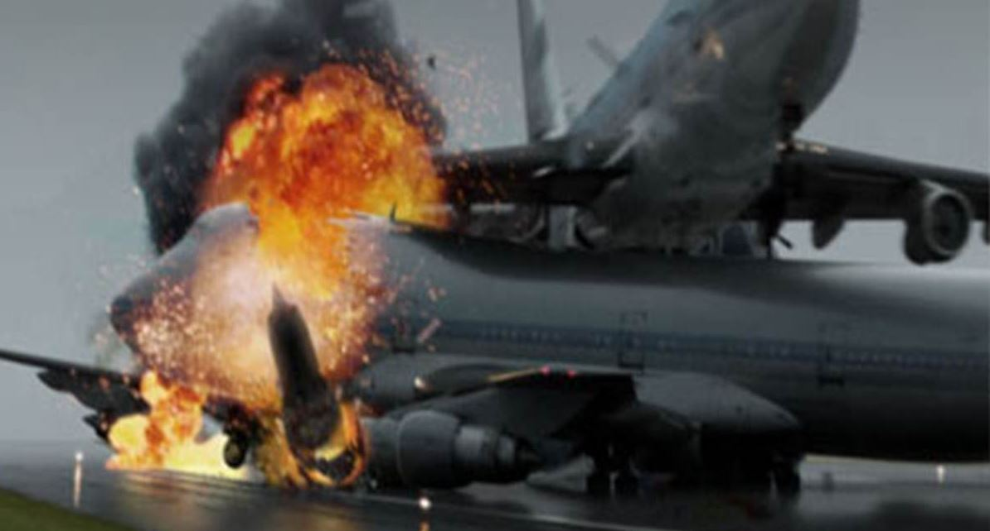
Aviation Safety:
Aviation safety is the field concerned with the prevention of accidents and incidents in the operation of aircraft. It includes the study of human factors, accidents, and technical failures in the aviation industry. There are many organizations that work to promote aviation safety, including the Pakistan Civil Aviation Authority (PCAA) in Pakistan and
National Transportation Safety Board(NTSB) in US. Aviation safety is of paramount importance, as even small errors or failures can have serious consequences when operating aircraft.

Slide 7
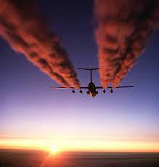
Environmental impacts of Aviation:
Greenhouse gas emissions:
Aviation is a significant contributor to climate change, as the burning of fossil fuels by aircraft releases greenhouse gases such as carbon dioxide (CO2) into the atmosphere.
Air quality:
The emissions from aircraft engines, including nitrogen oxides (NOx), particulate matter, and volatile organic compounds (VOCs), can have negative impacts on air quality.

Slide 8
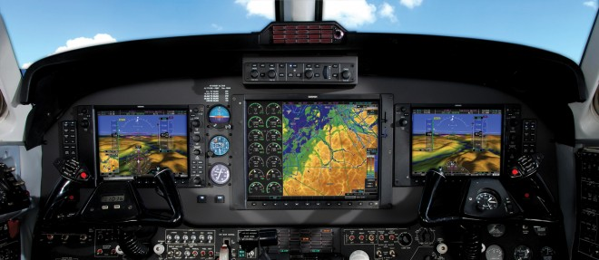
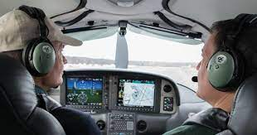
Inventions in Aviation:
There are many everyday items that were originally developed for use in the aviation industry. Here are a few examples :
GPS (Global Positioning System): This satellite-based navigation system was initially developed for military use,but is now widely used in a variety of applications, including aviation.
Scratch-resistant lenses: Scratch-resistant coatings for eyeglass lenses were developed for pilots, who needed durable eyewear that could withstand the rigors of flight.
Noise-cancelling headphones: These headphones were developed to help pilots and crew communicate more effectively in the noisy environment of an aircraft cockpit.
Memory foam: This type of foam was developed by NASA to help cushion and support astronauts during the stresses of space travel. It is now used in a variety of products, including mattresses, pillows, and seats.

Slide 9
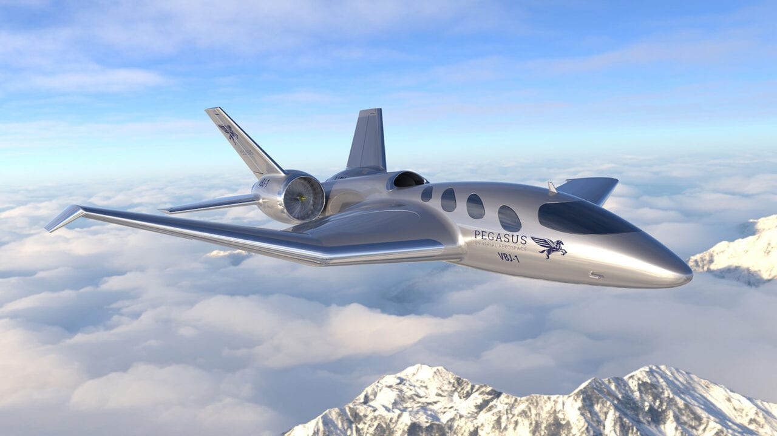
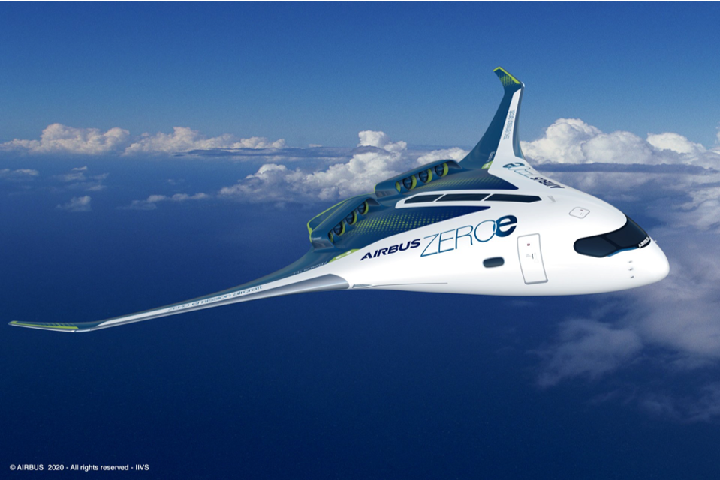
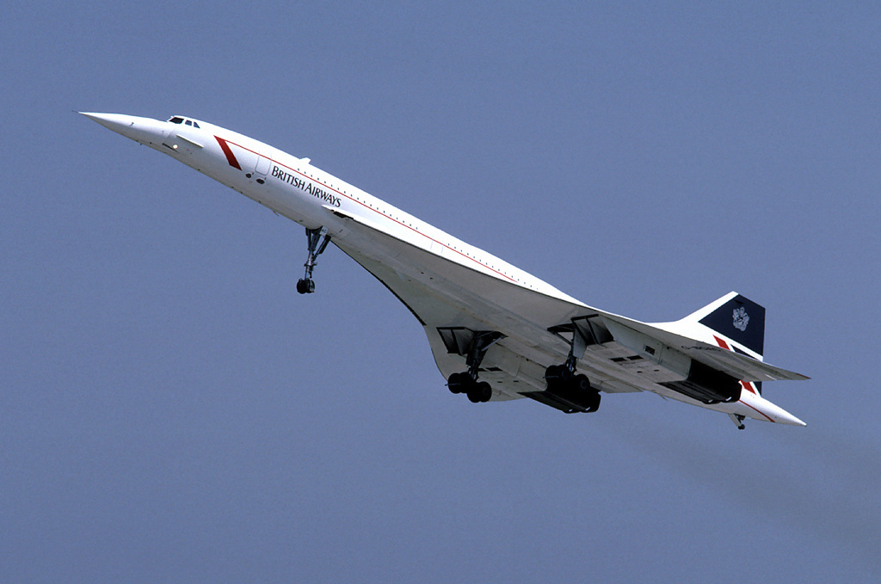
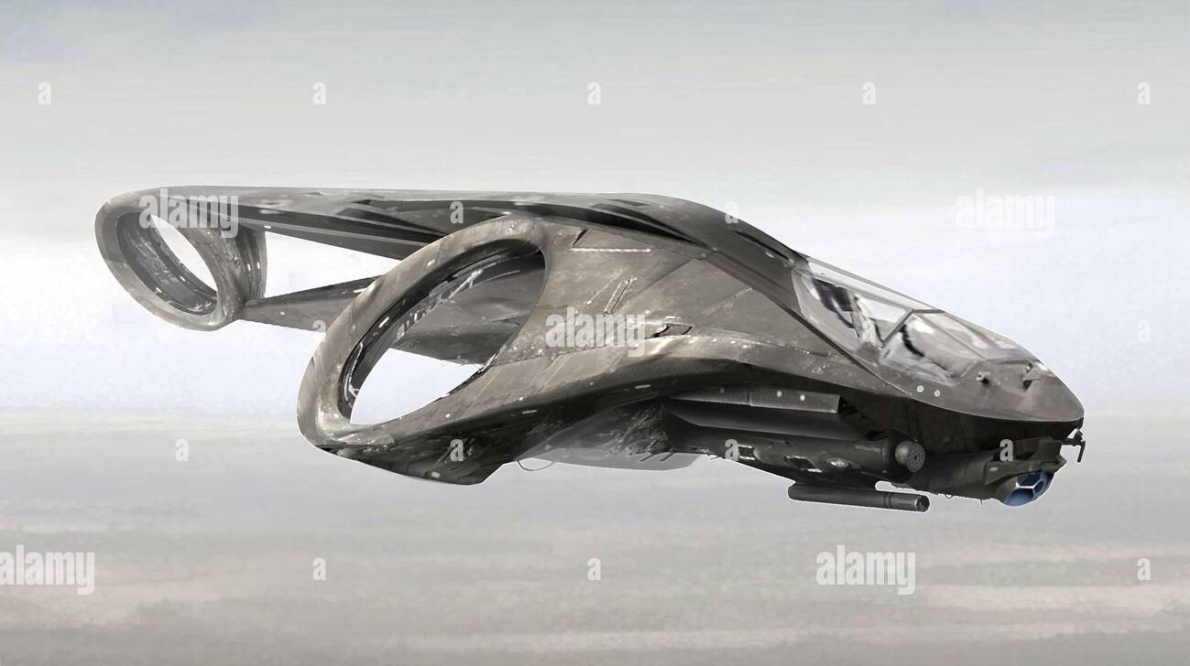
Future of aviation
There are several exciting developments in the field of aviation that are expected to shape the future of the industry.
Some of the key trends include the increasing use of electric and hybrid aircraft and the development of supersonic and hypersonic travel.
Airbus in this regard has partially succeeded in making first hydrogen powered zero carbon emission aircraft model.

Slide 10
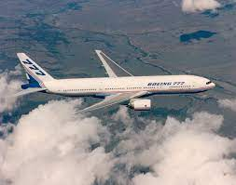
THANK YOU☺

